Slide 1
NIPT genotyping analysis 101
Xinming Zhuo

Slide 2
dependency
BWA v0.7.5a-r405
Samtools v1.5
Bcftools v1.6
Bam-readcount v0.7.4
Pear v0.9.10
BBTools v35.85
R v3.2.5

Slide 3
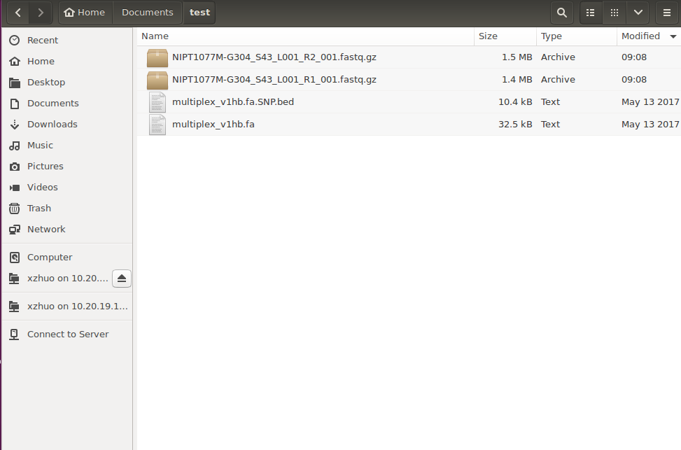
Have the sample and reference file ready

Slide 4
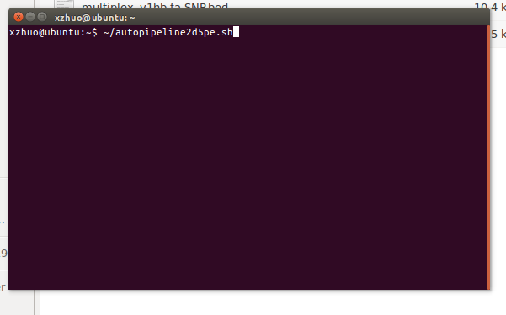
Open terminal and type in command

Slide 5
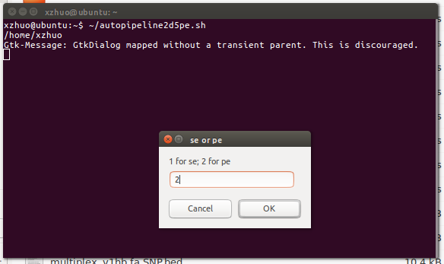
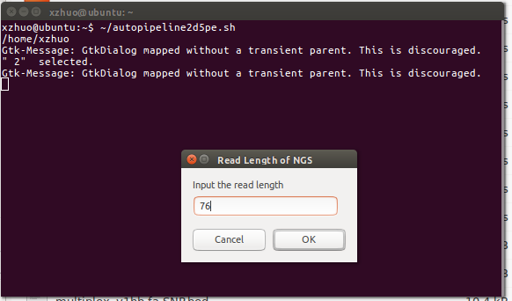
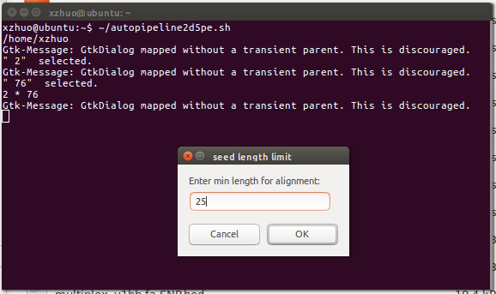
Dialogue box: enter your choice

Slide 6
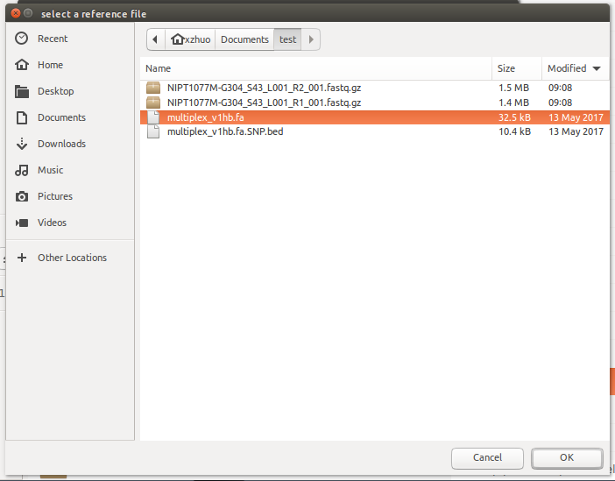
Select your referenence of choice

Slide 7
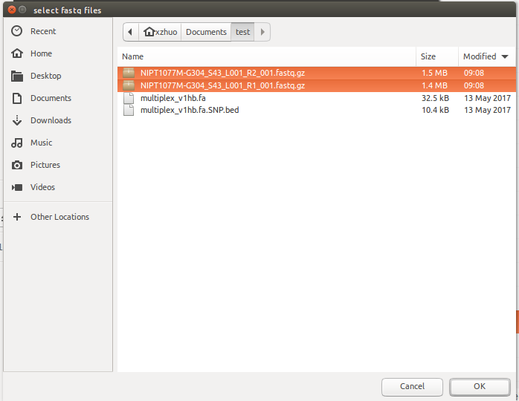
Select sample files (multi-selection)

Slide 8
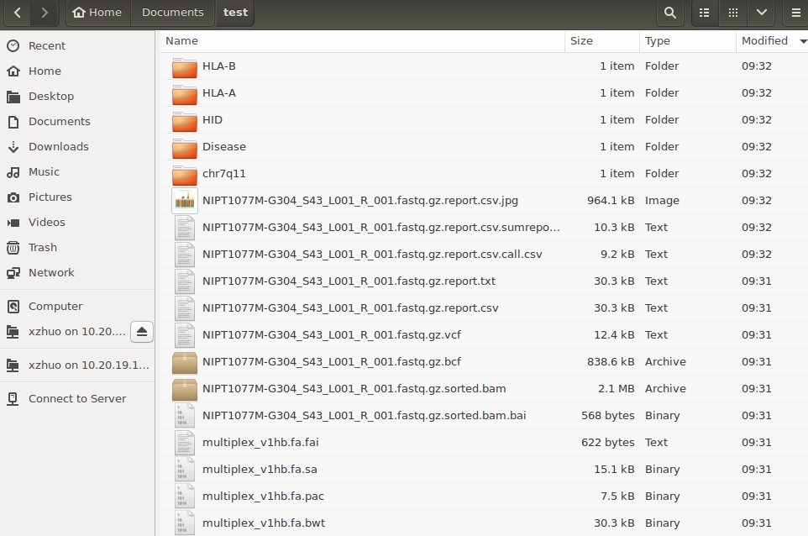
Generate variant files

Slide 9
SNPtyping

Slide 10
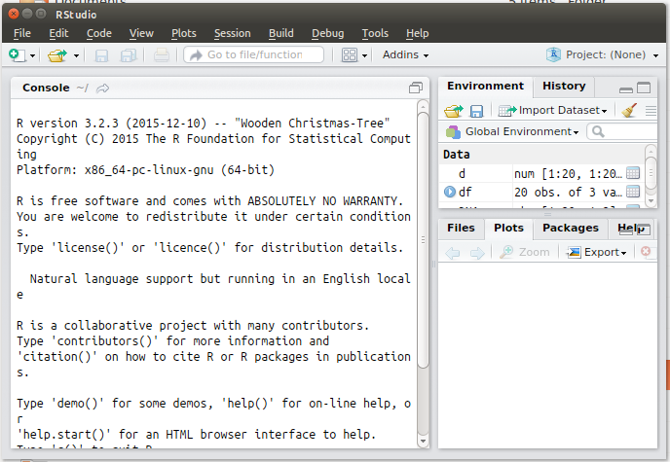
Open R (version 3.2.3)

Slide 11
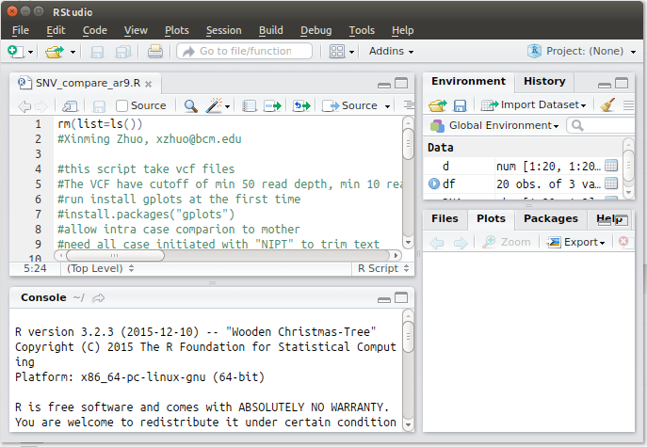
Open script for SNP comparison and Run

Slide 12
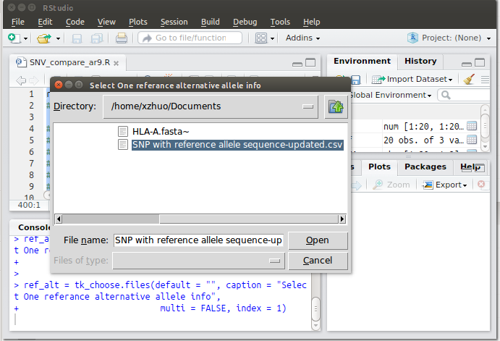
Select SNP annotation file

Slide 13
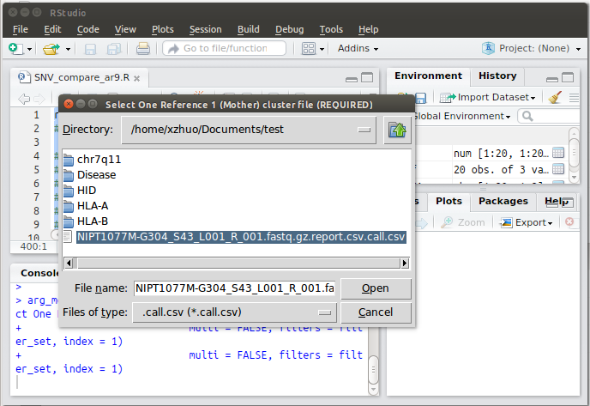
Select mother cluster file, father (optional) and candidate file

Slide 14
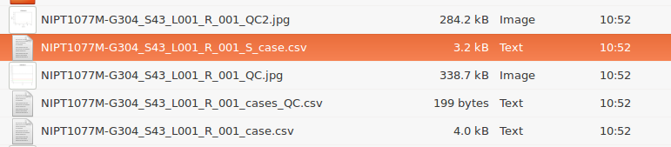
Generate new files

Slide 15
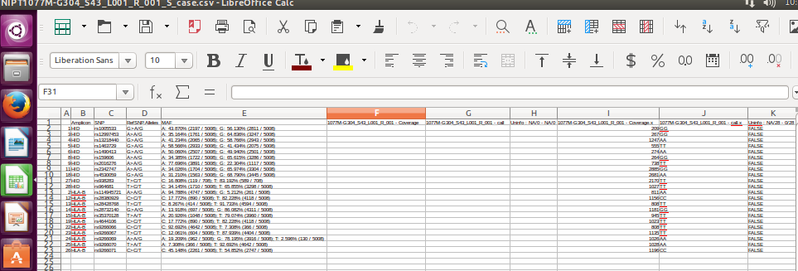
SNP comparison result

Slide 16
Haplotyping

Slide 17
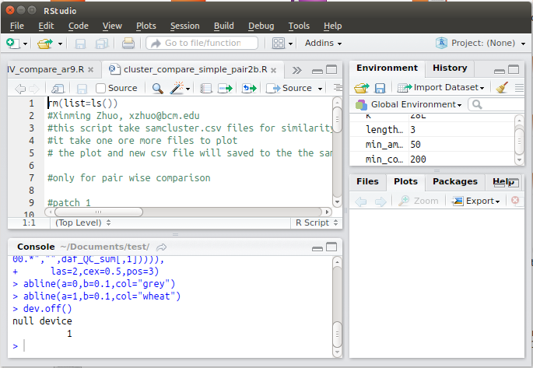
Haplotype comparison

Slide 18
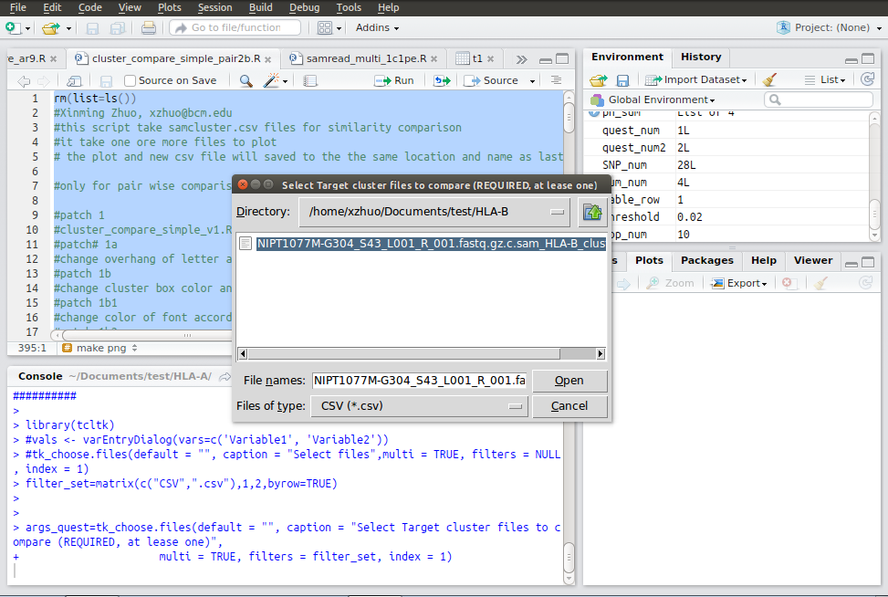
In the dialogue Box select file to compare

Slide 19
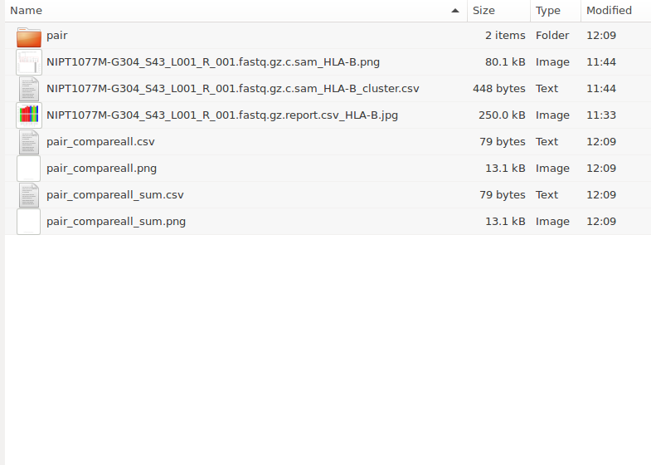
Generate haplotype comparison files

Slide 20
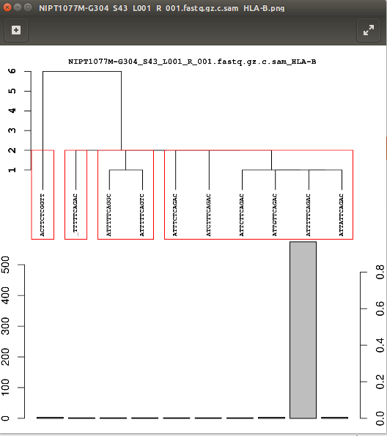
Different sample will exhibit in different color and group into different groups

